Slide 1


From Missing Intensities to Uncertainty Quantification: A Conjugate Bayesian Framework for Differential Proteomics
Marie Chion
Joint work with Arthur Leroy (INRAE)
29 January 2026
SMPGD, Grenoble

Slide 2



Differential proteomic analysis
What?
Comparison of peptide or protein intensities in different biological conditions.
vs
How?
Condition A
Condition B
Linear model:
$y_{pkn}=μ_{pk}+ε_{pkn}$, ${ ε}_{p} \sim 𝒩(0,σ_{p}^{2}\text{)}$
Hypothesis testing:
$H_{0}: μ_{A}− μ_{B}=0$
t-tests, limma, …
N samples
P
peptides
$$y_{pAn}$$
$$y_{pBn}$$

Slide 3




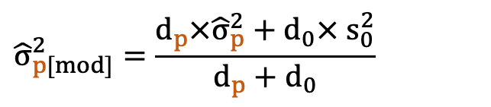

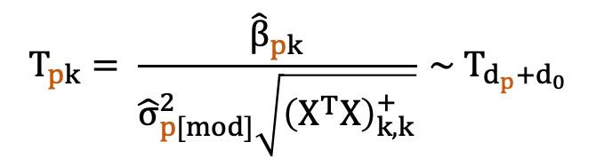

About limma
Linear hierarchical model:
$$y_{p}={(y_{p1}\text{, …, }y_{pN})}^{T}$$
$y_{p}=Xβ_{p}+ε_{p}$, $ε_{p} \sim 𝒩(0,σ_{p}^{2}$)
$$β_{p}={(y_{p1}\text{, …, }y_{pN})}^{T}$$
$X=$ N x K design matrix
Prior:
From posterior:
$${\hat{σ}}_{p[mod]}^{2}=\frac{d_{p}×{\hat{σ}}_{p}^{2}+d_{0}× s_{0}^{2}}{d_{p}+d_{0}}$$
$σ_{p}^{2} \sim χ^{−2}(d_{0},s_{0}^{2}$)
Smyth (2004)
Moderated t-test:
$$T_{pk}= \frac{{\hat{β}}_{pk}}{{\hat{σ}}_{p[mod]}^{2}\sqrt{{\left(X^{T}X\right)}_{k,k}^{+}}} \sim T_{d_{p}+d_{0}}$$
Under $H_{0}:β_{pk}=0,$

Slide 4
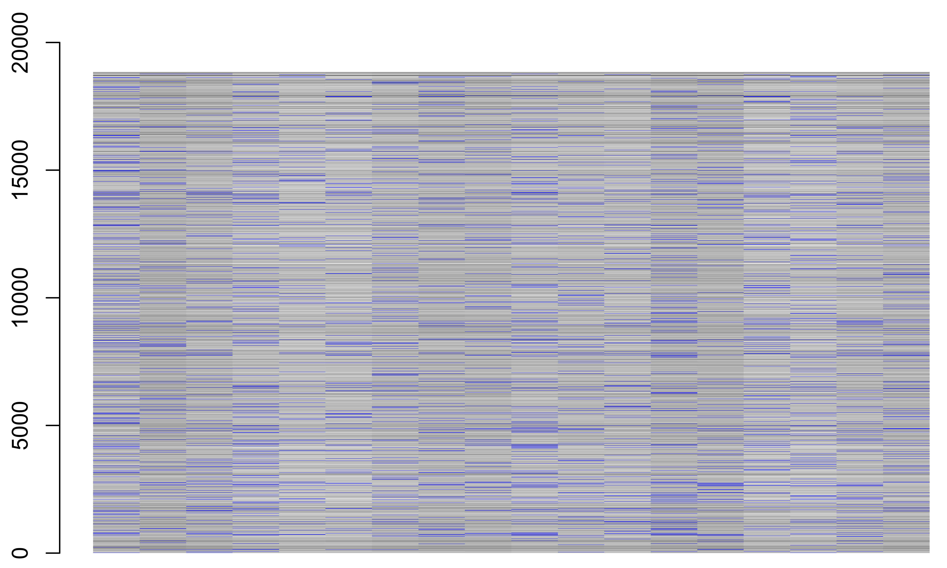
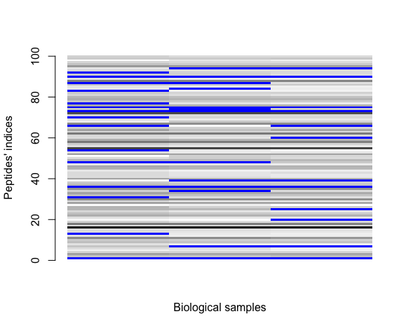
Missing values in proteomics datasets
Typical missingness pattern
in a proteomics experiment.
(5-15% missing values)
Peptides
Biological samples

Slide 5
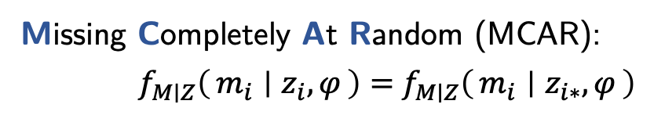
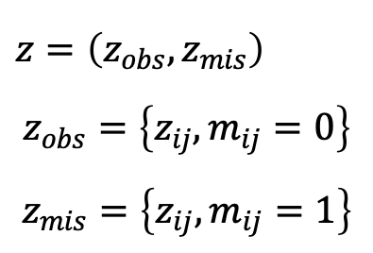
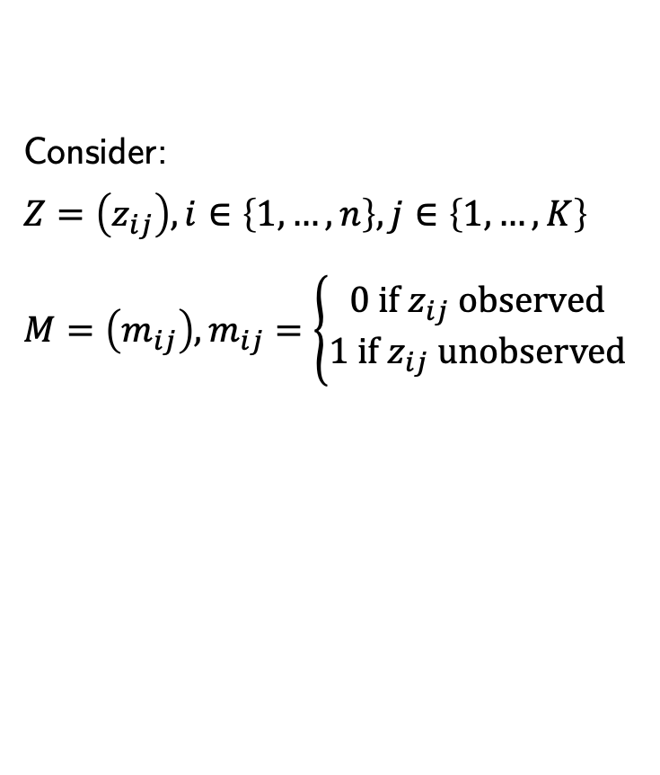
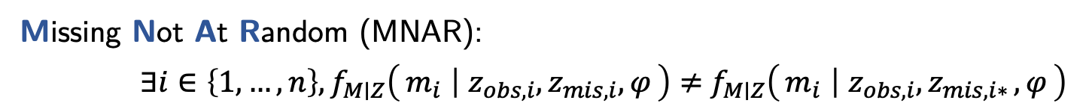
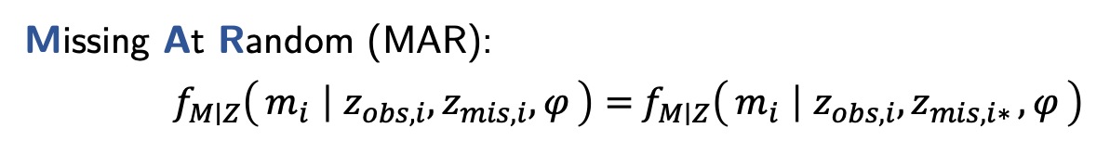
Missing values mechanisms
Consider:
$$Z=\left(z_{ij}\right), i∈\left\{1,…,n\right\}, j∈\left\{1, …, K\right\}$$
$$M=\left(m_{ij}\right), m_{ij}=\left\{\begin{aligned}0 if z_{ij} observed \\ 1 if z_{ij} unobserved\end{aligned}\right.$$
$$z=\left(z_{obs},z_{mis}\right)$$
$$z_{obs}=\left\{z_{ij}, m_{ij}=0\right\}$$
$$z_{mis}=\left\{z_{ij}, m_{ij}=1\right\}$$
Missing Completely At Random (MCAR):
$f_{M∣Z}\left(m_{i} ∣ z_{i},φ\right)=$ $f_{M∣Z}\left(m_{i} ∣ z_{i∗},φ\right)$
Missing At Random (MAR):
$f_{M∣Z}\left(m_{i} ∣ z_{obs,i},z_{mis,i},φ\right)=$ $f_{M∣Z}\left(m_{i} ∣ z_{obs,i}{,z}_{mis,i∗},φ\right)$
Missing Not At Random (MNAR):
${∃i∈\left\{1,…,n\right\}, f}_{M∣Z}\left(m_{i} ∣ z_{obs,i},z_{mis,i},φ\right)≠$ $f_{M∣Z}\left(m_{i} ∣ z_{obs,i}{,z}_{mis,i∗},φ\right)$

Slide 6
Missing values nomenclature
In quantitative proteomics, various causes:
biochemical, analytical, bioinformatical…
… that can be intrinsically related.
Condition | 1 |  |  | 2 |  |  | 3
Sample | 1 | 2 | 3 | 4 | 5 | 6 | 7 | 8 | 9
Intensity | 23.0 | 22.4 | 21.8 | 21.4 | NA | 21.2 | NA | NA | NA
Partially Observed Value
  Missing At Random: propagation of errors not explained by the nature of the peptide
  Missing Not At Random: measured intensity below the limit of quantification (left-censored)
Missing in an Entire Condition
  Missing Not At Random (left-censored)
 Wieczorek et al., 2019

Slide 7
Motivation
Missing values
Imputation = Replace a missing value with a user-defined one
→ Complete dataset? CompletED dataset.
Imputed values not as reliable as observed ones.
→ Accounting for the multiple imputation induced variability in hypothesis testing.
 Chion et al., 2022
Inter-peptide correlation
No existing methods (e.g. intra-protein correlation)
→ Multivariate modelling
Quantification of uncertainty
Limited in current state-of-the-art methods, yet key in translational research
→ Bayesian statistics
 Crook et al., 2022

Slide 8
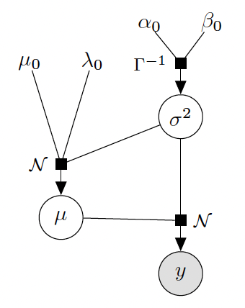


Bayesian inference for Gaussian-inverse-Gamma conjugate priors
Linear hierarchical model:
$y_{p}=μ_{p}+ε_{p}$, $ε_{p} \sim 𝒩(0,σ_{p}^{2}$)
Priors:
$$μ_{p},σ_{p}^{2} \sim {𝒩Γ}^{−1}(μ_{0},λ_{0},α_{0},β_{0})$$

Slide 9
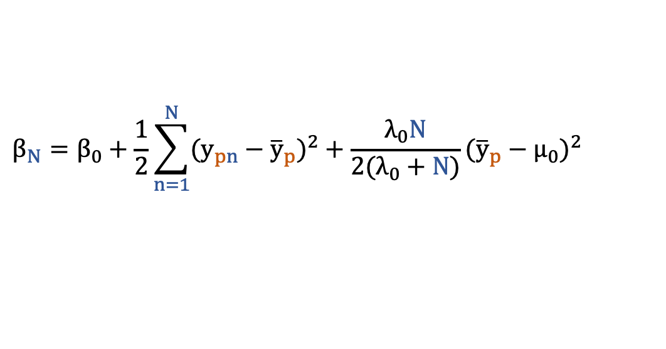
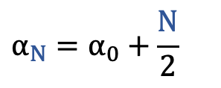

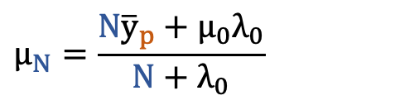

Bayesian inference for Gaussian-inverse-Gamma conjugate priors
Linear hierarchical model:
$y_{p}=μ_{p}+ε_{p}$, $ε_{p} \sim 𝒩(0,σ_{p}^{2}$)
Priors:
$$μ_{p},σ_{p}^{2} \sim {𝒩Γ}^{−1}(μ_{0},λ_{0},α_{0},β_{0})$$
Posteriors:
$$μ_{p},σ_{p}^{2}|y_{p}\sim {𝒩Γ}^{−1}(μ_{N},λ_{N},α_{N},β_{N})$$
$$λ_{N}=λ_{0}+N$$
$$α_{N}=α_{0}+\frac{N}{2}$$
$$μ_{N}=\frac{N{\overline{y}}_{p}+μ_{0}λ_{0}}{N+λ_{0}}$$
$$β_{N}=β_{0}+\frac{1}{2}\sum_{n=1}^{N}{{(y_{pn}−{\overline{y}}_{p})}^{2}}+\frac{λ_{0}N}{2(λ_{0}+N)}{({\overline{y}}_{p}−μ_{0})}^{2}$$

Slide 10
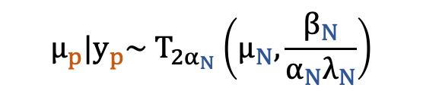
Bayesian inference for Gaussian-inverse-Gamma conjugate priors
Linear hierarchical model:
$y_{p}=μ_{p}+ε_{p}$, $ε_{p} \sim 𝒩(0,σ_{p}^{2}$)
Priors:
$$μ_{p},σ_{p}^{2} \sim {𝒩Γ}^{−1}(μ_{0},λ_{0},α_{0},β_{0})$$
Posteriors:
$$μ_{p},σ_{p}^{2}|y_{p}\sim {𝒩Γ}^{−1}(μ_{N},λ_{N},α_{N},β_{N})$$
$$λ_{N}=λ_{0}+N$$
$$α_{N}=α_{0}+\frac{N}{2}$$
$$μ_{N}=\frac{N{\overline{y}}_{p}+μ_{0}λ_{0}}{N+λ_{0}}$$
$$β_{N}=β_{0}+\frac{1}{2}\sum_{n=1}^{N}{{(y_{pn}−{\overline{y}}_{p})}^{2}}+\frac{λ_{0}N}{2(λ_{0}+N)}{({\overline{y}}_{p}−μ_{0})}^{2}$$
$$μ_{p}|y_{p}\sim T_{2α_{N}}\left(μ_{N},\frac{β_{N}}{α_{N}λ_{N}}\right)$$

Slide 11
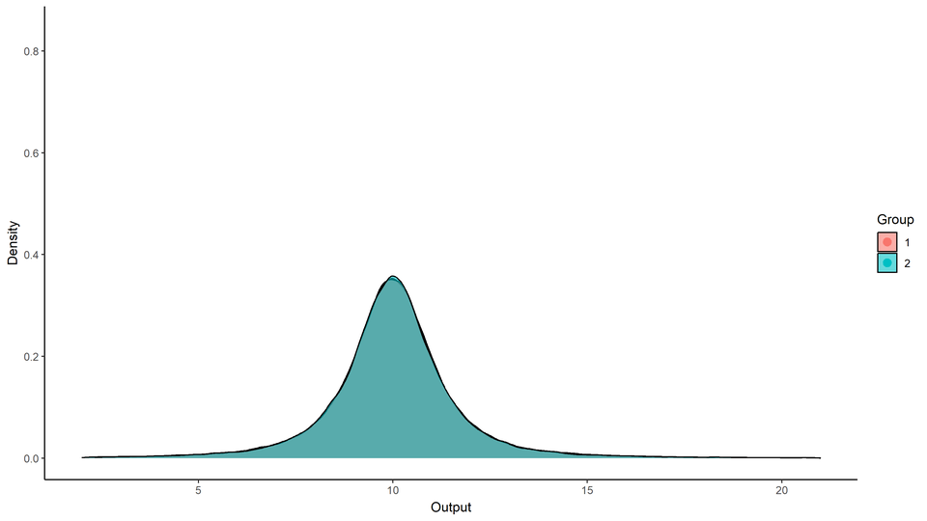
A GIF means more than a formula…

Slide 12
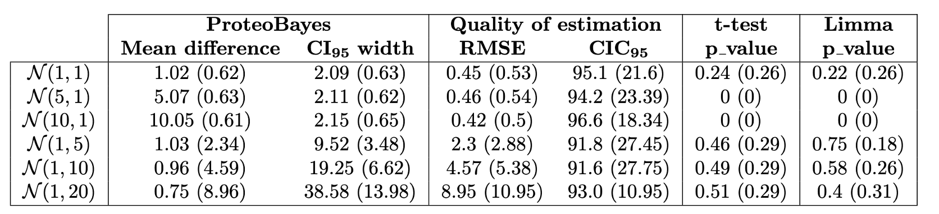
Evaluation on simulated data
Results for 1,000 realisations of comparisons with $𝒩\left(0,1\right)$ with 5 samples per group

Slide 13
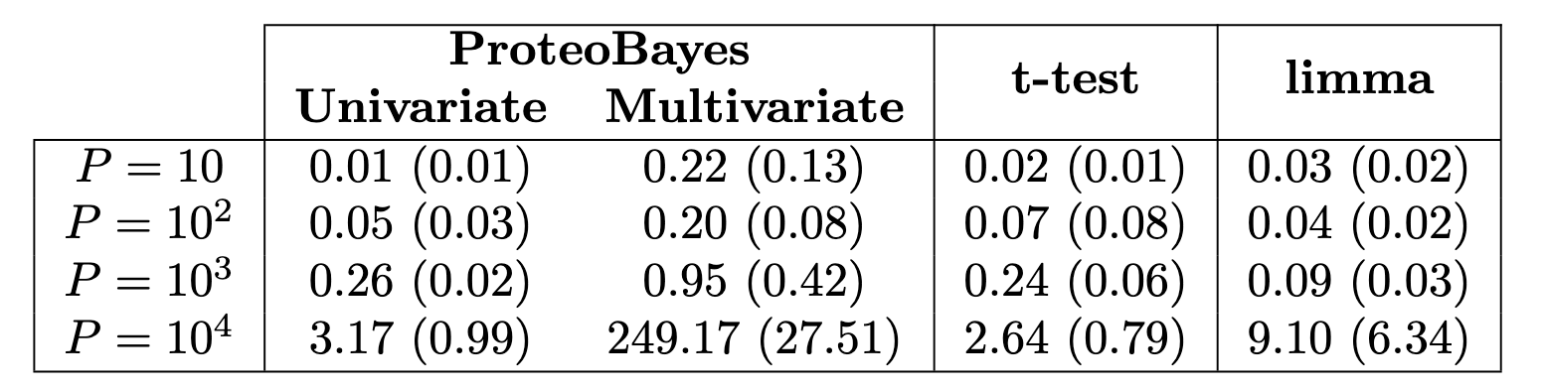
Evaluation on simulated data
Results for 1,000 realisations of comparisons with $𝒩\left(0,1\right)$ with 5 samples per group
On average, very accurate recovery of mean differences, as fast as t-test.

Slide 14
Evaluation on simulated data
Results for 1,000 realisations of comparisons with $𝒩\left(0,1\right)$ with 5 samples per group
On average, very accurate recovery of mean differences, as fast as t-test.
As expected, uncertainty increases along with variance in data.

Slide 15
Evaluation on simulated data
Results for 1,000 realisations of comparisons with $𝒩\left(0,1\right)$ with 5 samples per group
On average, very accurate recovery of mean differences, as fast as t-test.
As expected, uncertainty increases along with variance in data.
In comparison, p-values of t-tests are quite uninformative and difficult to interpret.

Slide 16
Evaluation on simulated data
Results for 1,000 realisations of comparisons with $𝒩\left(0,1\right)$ with 5 samples per group
On average, very accurate recovery of mean differences, as fast as t-test.
As expected, uncertainty increases along with variance in data.
In comparison, p-values of t-tests are quite uninformative and difficult to interpret.
Low error and well-calibrated uncertainty quantification: empirical results theoretically expected.

Slide 17
Evaluation on a well-calibrated dataset
Experiment:
400ng Arabidopsis thaliana constant background
0.05 fmol
0.25 fmol
0.5 fmol
1.25 fmol
2.5 fmol
5 fmol
10 fmol
+ UPS1 spiked-in
UPS1: Universal proteomics standard 1, equimolar mix of 48 Human proteins (Merck)
→ mimics a real case of differential quantitative proteomic analysis

Slide 18
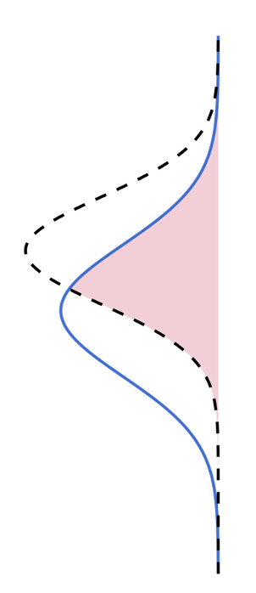
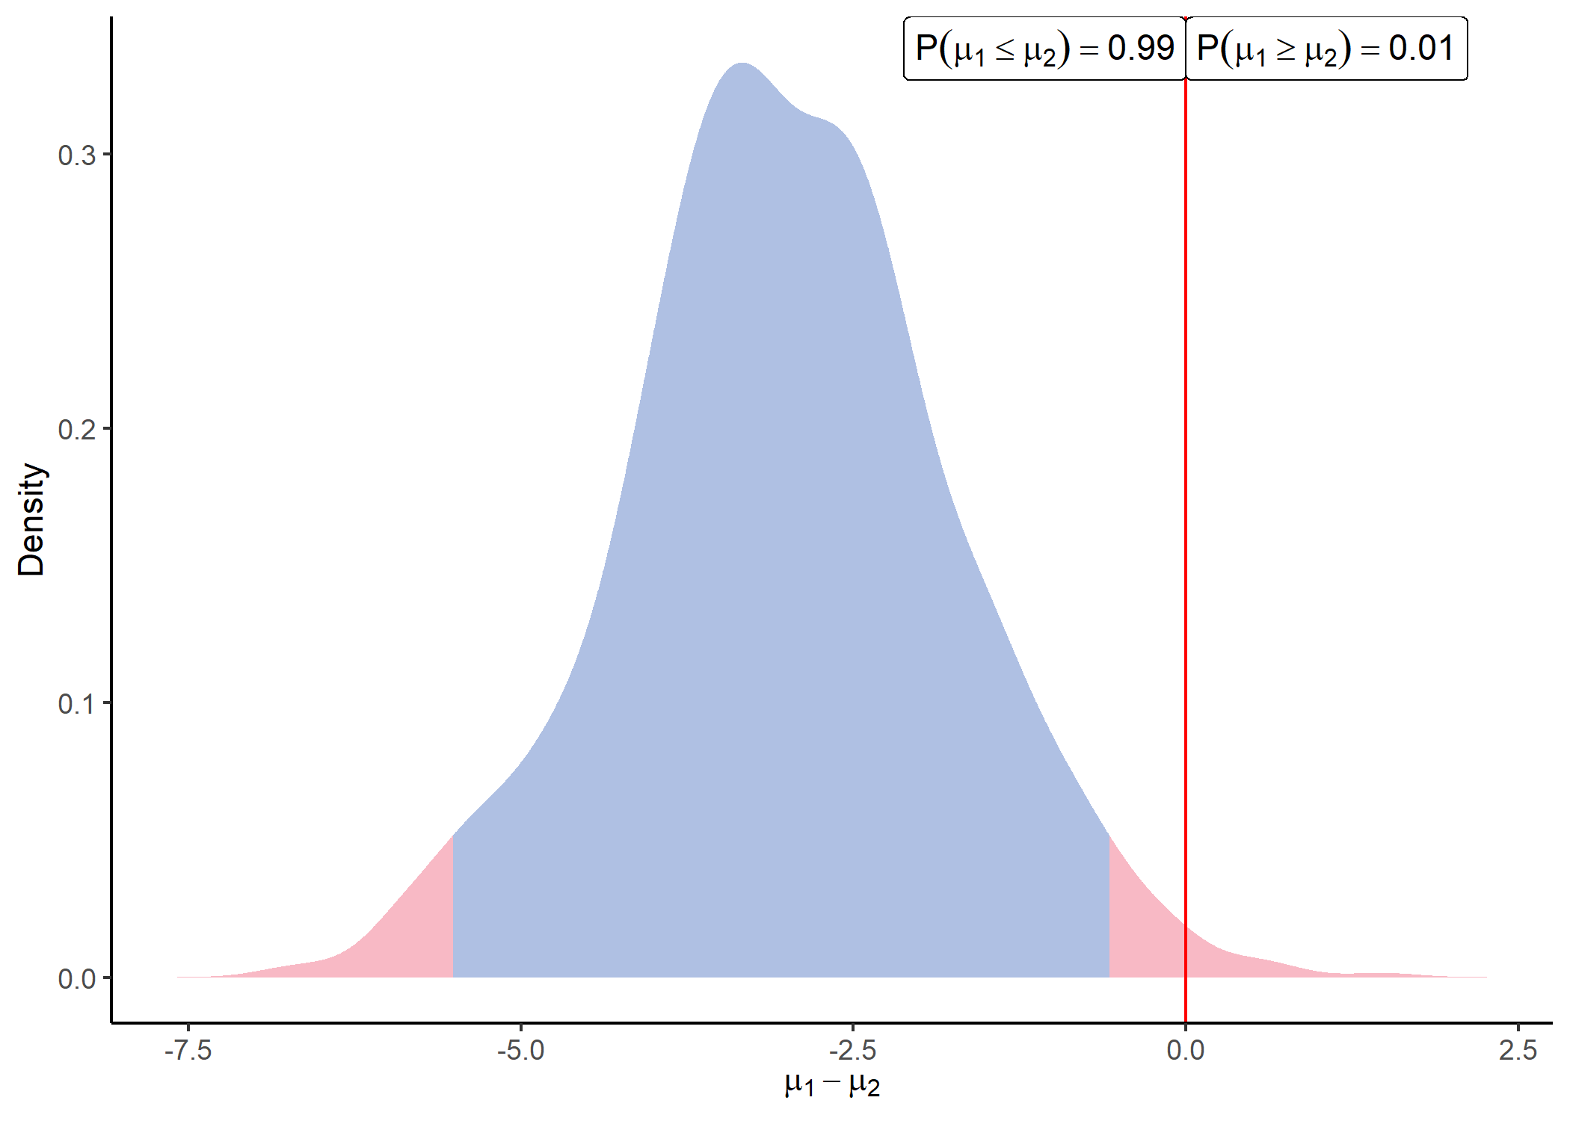

How to interpret probabilistic differential analysis
Decision rule based on the overlap coefficient
“What are the probable values of $μ_{1}−μ_{2}$?”
Distribution of difference of means values
Comparison with 0 to assess the effect size
Inference in terms of probability
→ Decision is all about the quantification of uncertainty

Slide 19
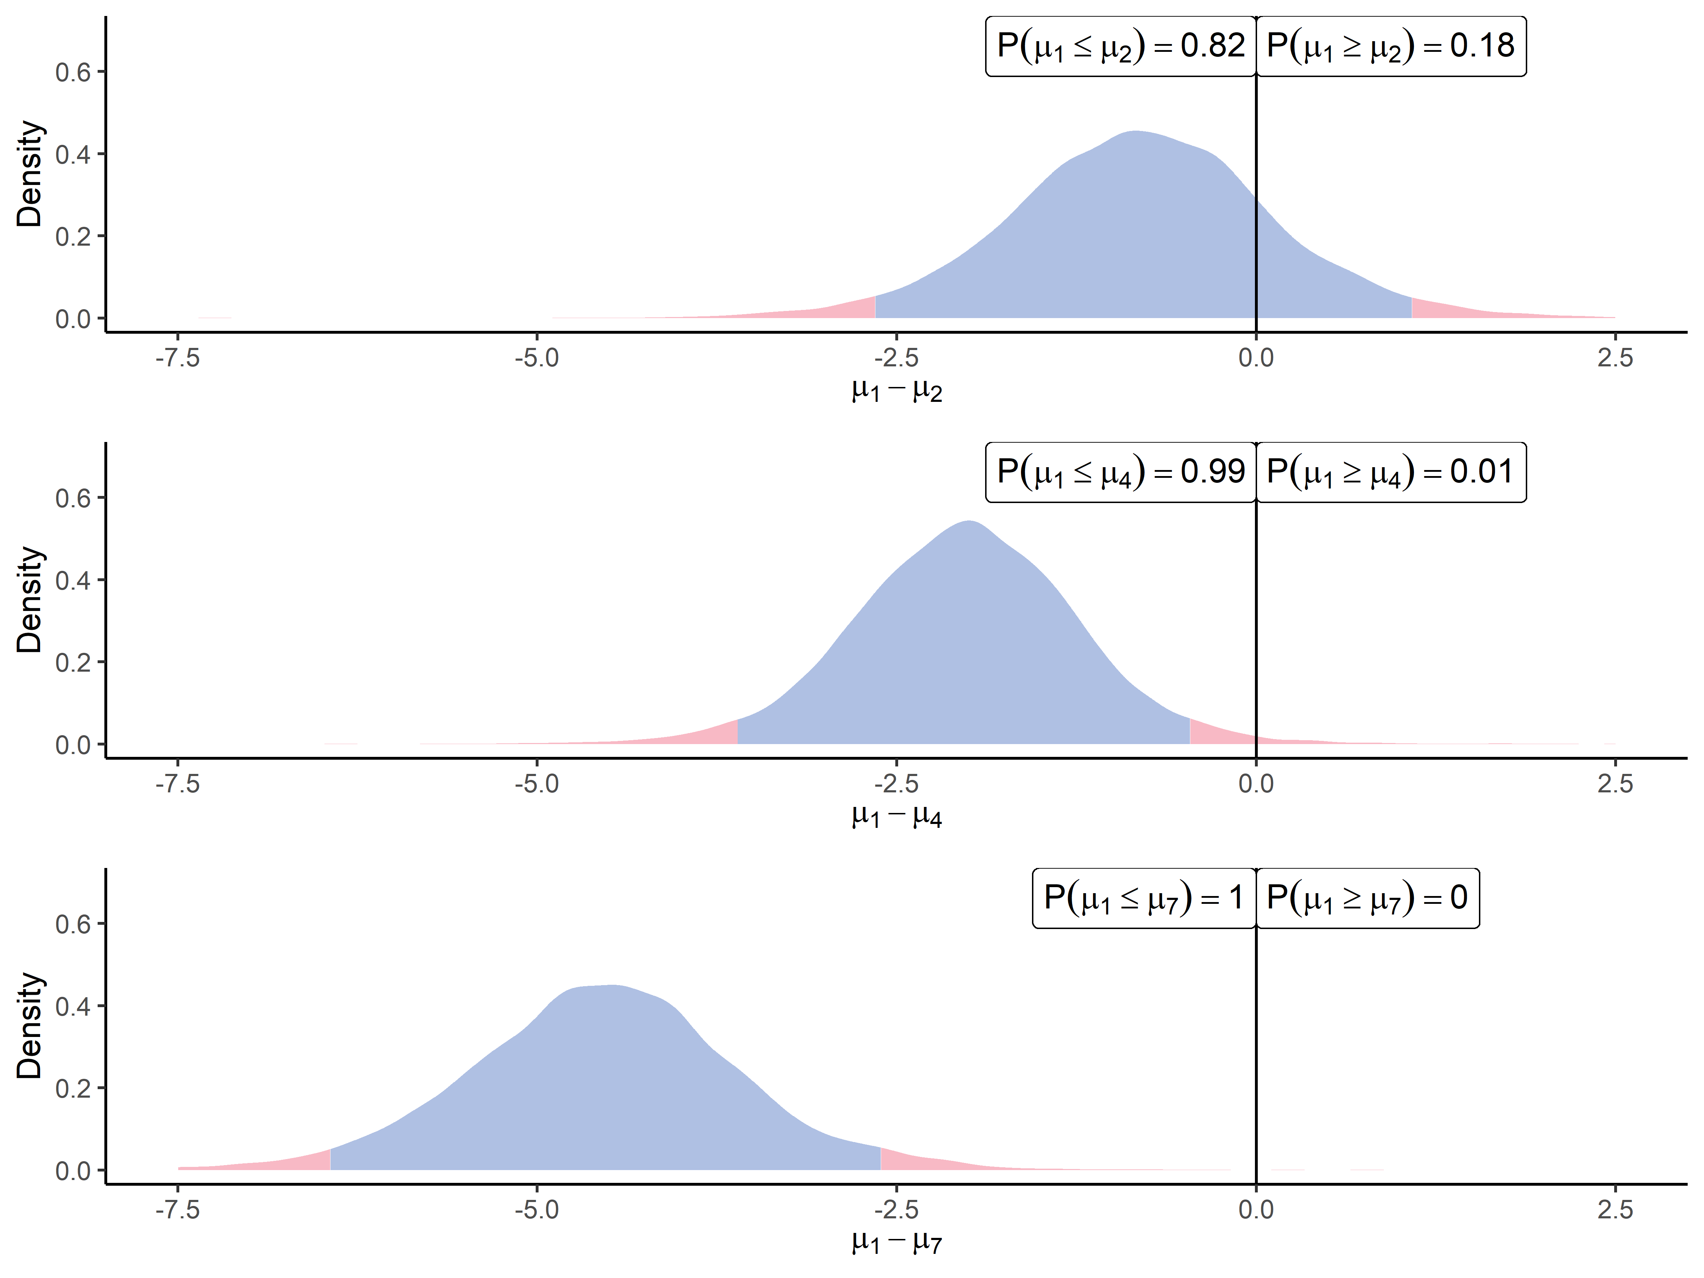
Acknowledging the effect size
AALEELVK (P12081ups|SYHC HUMAN UPS)

Slide 20
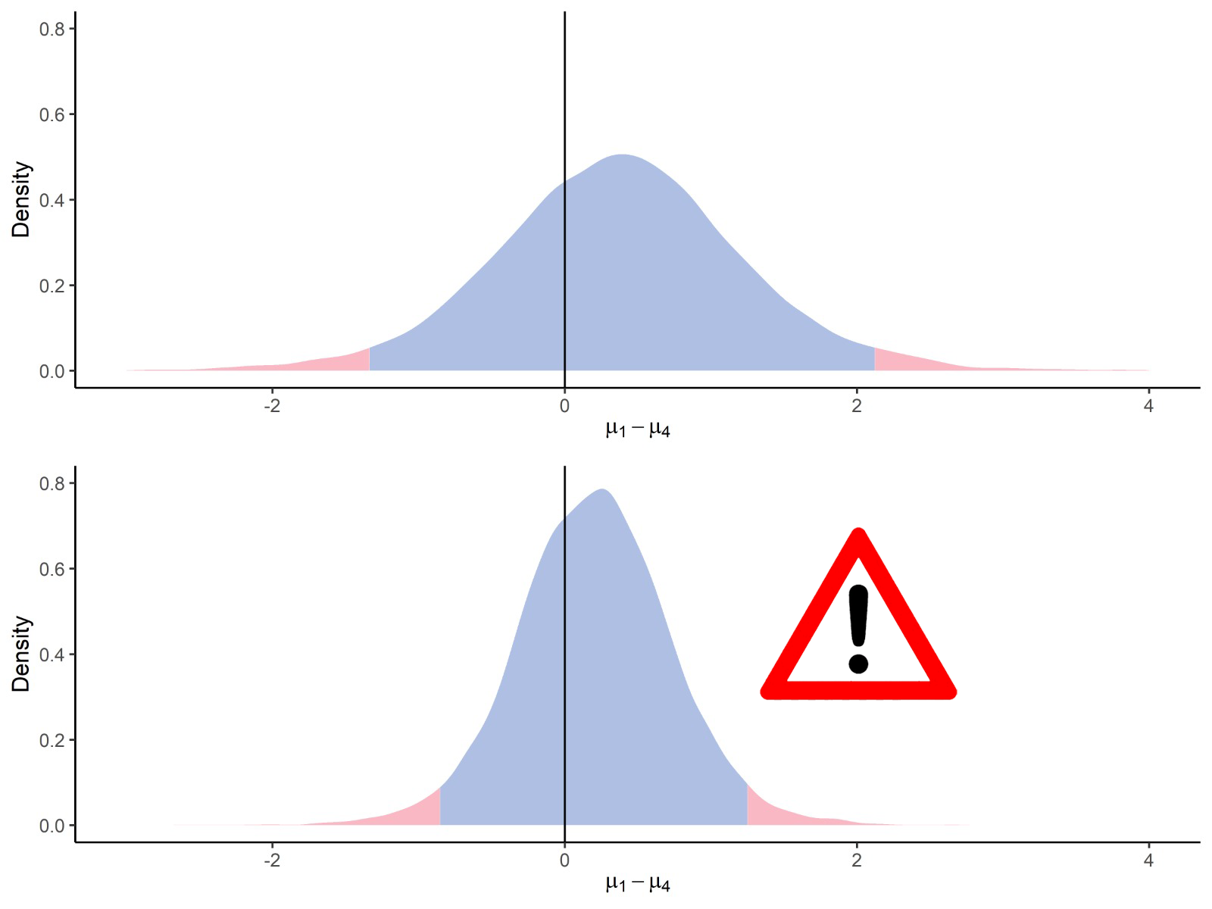


The mirage of imputed data
EVQELAQEAAER (sp|F4I893|ILA ARATH)
Dataset with missing values
e.g. $\left\{1, 3, 7, 9, .\right\}$
Imputed dataset
$$\text{e}\text{.}\text{g}\text{.} \left\{1, 3, 7, 9, 5\right\}$$

Slide 21
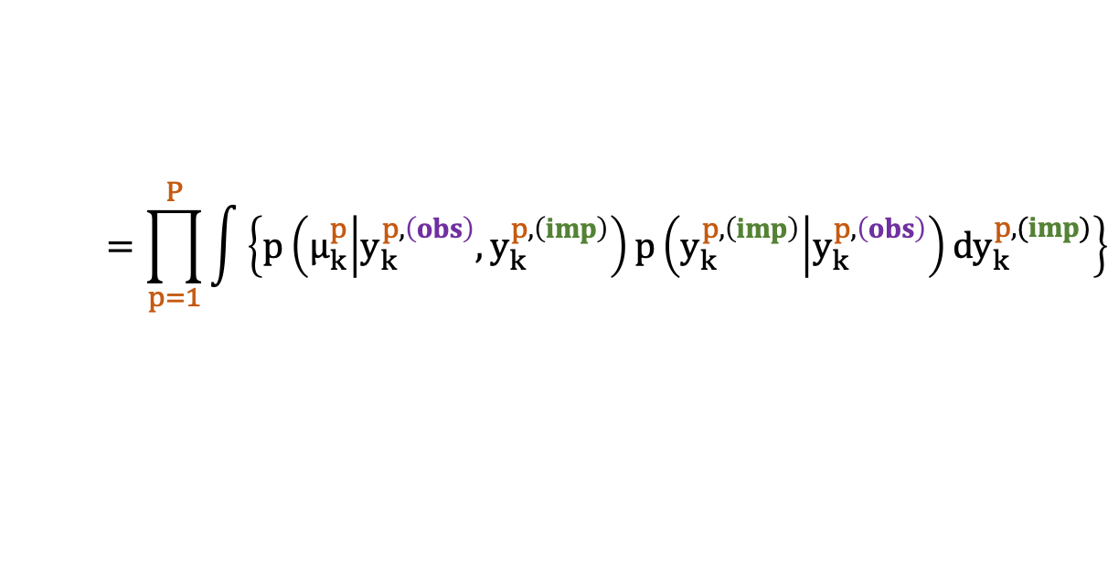
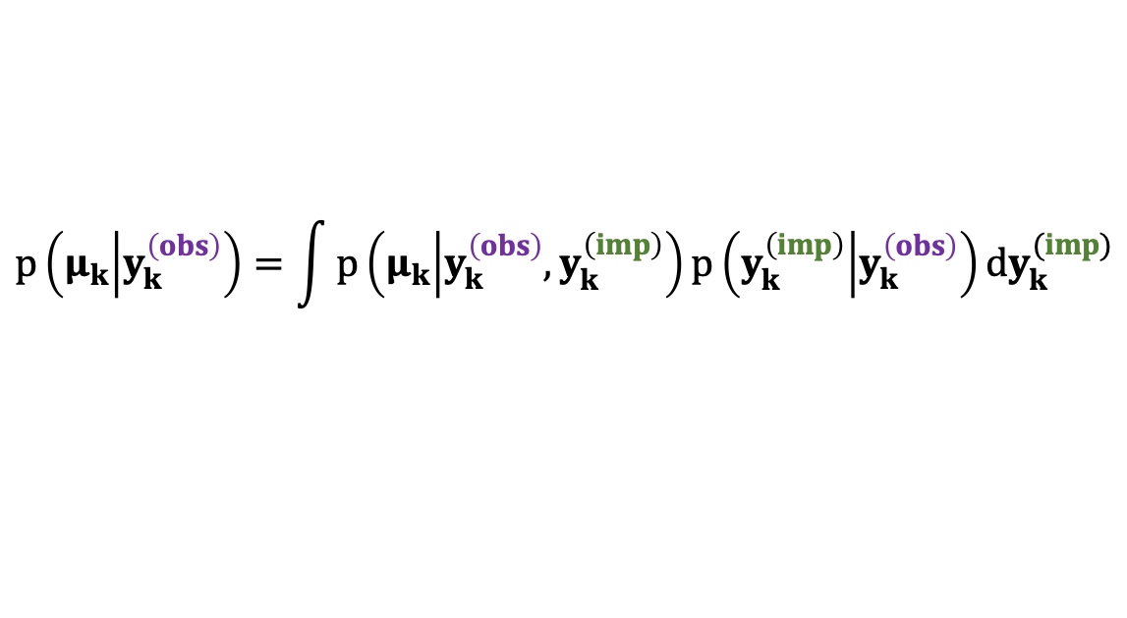
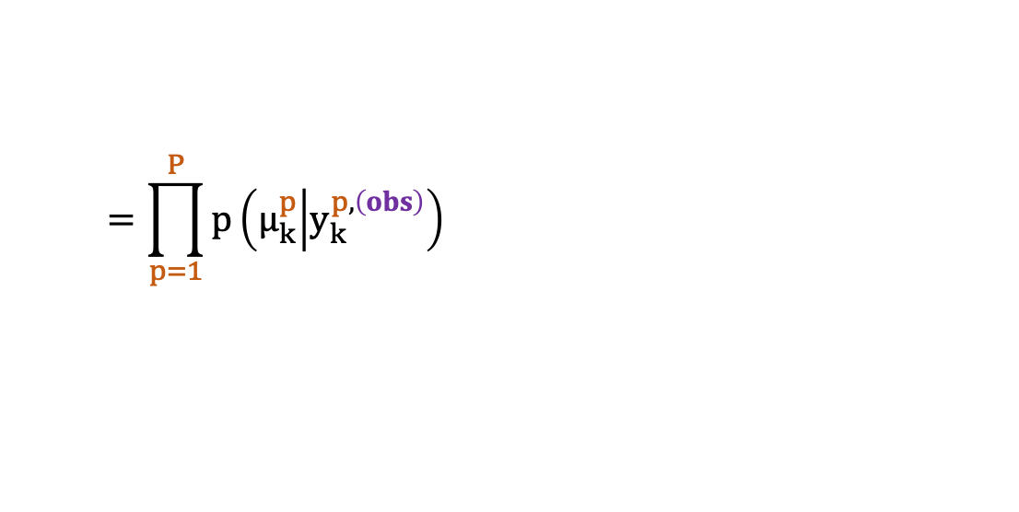
Imputation with uncorrelated peptides?
$$p\left(μ_{k} | y_{k}^{\left(obs\right)}\right)=\int{{p\left(μ_{k} | y_{k}^{\left(obs\right)},y_{k}^{\left(imp\right)}\right)p\left(y_{k}^{\left(imp\right)} | y_{k}^{\left(obs\right)}\right)dy}_{k}^{(imp)}}$$
$$=\prod_{p=1}^{P}{\int{\left\{p\left(μ_{k}^{p} | y_{k}^{p,\left(obs\right)},y_{k}^{p,\left(imp\right)}\right)p\left(y_{k}^{p,\left(imp\right)} | y_{k}^{p,\left(obs\right)}\right){dy}_{k}^{p,(imp)}\right\}}}$$
$$=\prod_{p=1}^{P}{p\left(μ_{k}^{p} | y_{k}^{p,\left(obs\right)}\right)}$$
Observed data already bear all the useful information.
As if unobserved values could be ignored without effect on the posterior distribution.
Only when peptides are uncorrelated and MAR values

Slide 22
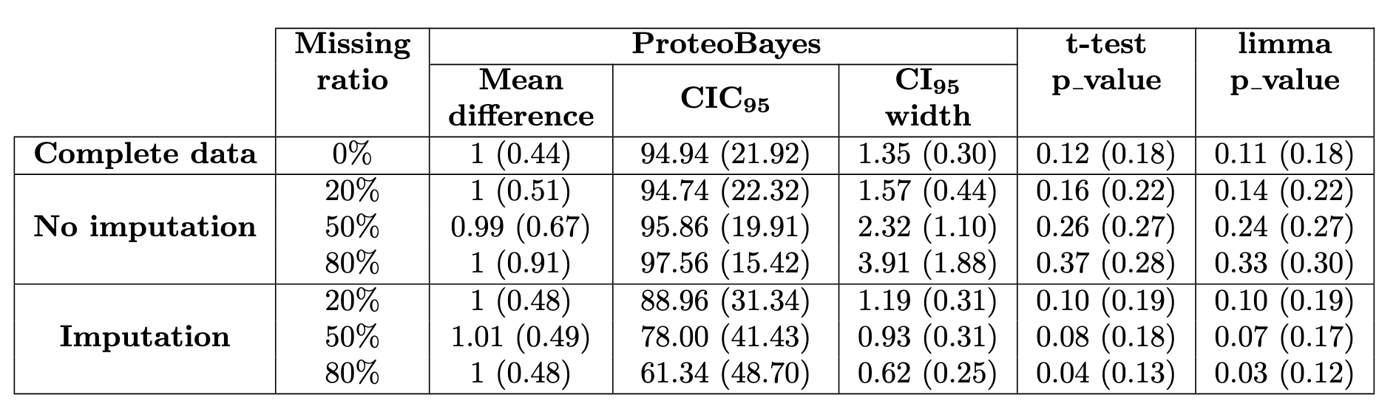
The mirage of imputed data
Results for 1,000 realisations of comparisons $𝒩\left(0,1\right)$ vs $𝒩\left(1,1\right)$ for 10 samples per group with missing values

Slide 23
The mirage of imputed data
Results for 1,000 realisations of comparisons $𝒩\left(0,1\right)$ vs $𝒩\left(1,1\right)$ for 10 samples per group with missing values
In all contexts, robust recovery of the mean difference regardless of missing data.

Slide 24
The mirage of imputed data
Results for 1,000 realisations of comparisons $𝒩\left(0,1\right)$ vs $𝒩\left(1,1\right)$ for 10 samples per group with missing values
In all contexts, robust recovery of the mean difference regardless of missing data.
Uncertainty calibration is not valid anymore when imputing missing data = overconfidence.

Slide 25
The mirage of imputed data
Results for 1,000 realisations of comparisons $𝒩\left(0,1\right)$ vs $𝒩\left(1,1\right)$ for 10 samples per group with missing values
In all contexts, robust recovery of the mean difference regardless of missing data.
Uncertainty calibration is not valid anymore when imputing missing data = overconfidence.
Hypothesis testing severely struggles with missing data, and no options seem desirable.

Slide 26
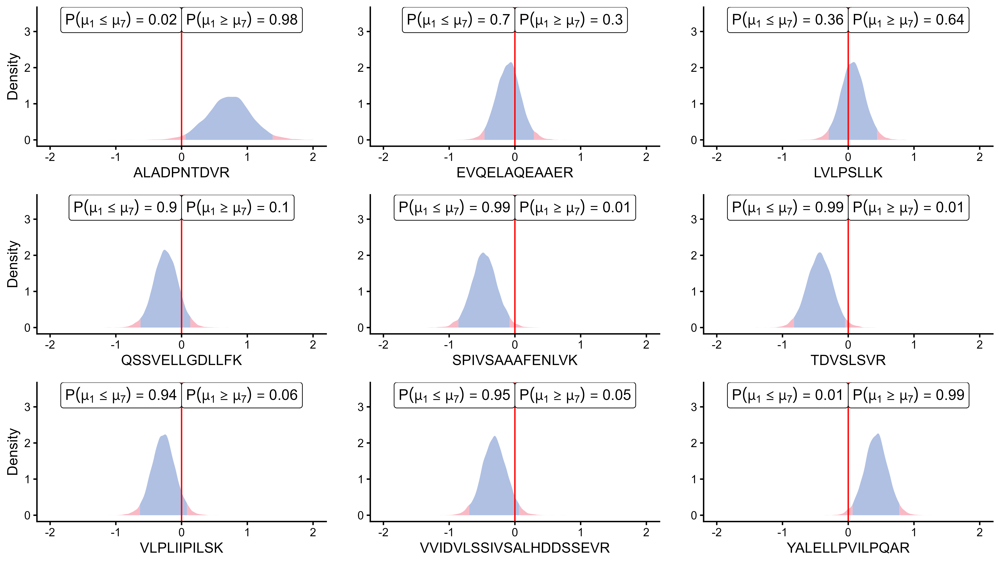
About protein inference
sp|F4I893|ILA ARATH

Slide 27
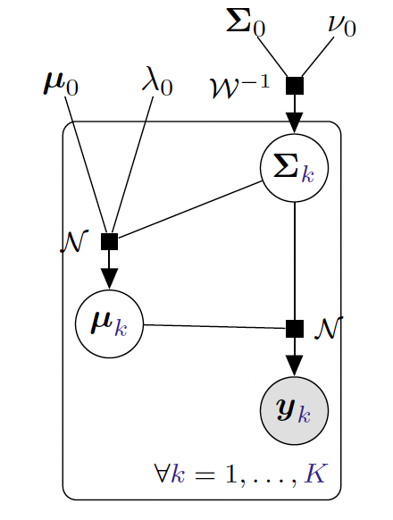

Extension to the multivariate case
Linear hierarchical model:
$$∀k=1,…,K, y_{k}=μ_{k}+ε_{k}, ε_{k} \sim 𝒩_{p}(0,Σ_{k}\text{)}$$
Priors:
$$μ_{k},Σ_{k}\sim {𝒩𝒲}^{−1}(μ_{0},λ_{0},Σ_{0},ν_{0})$$

Slide 28


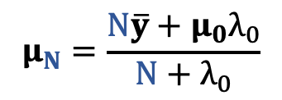

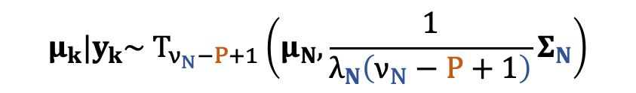
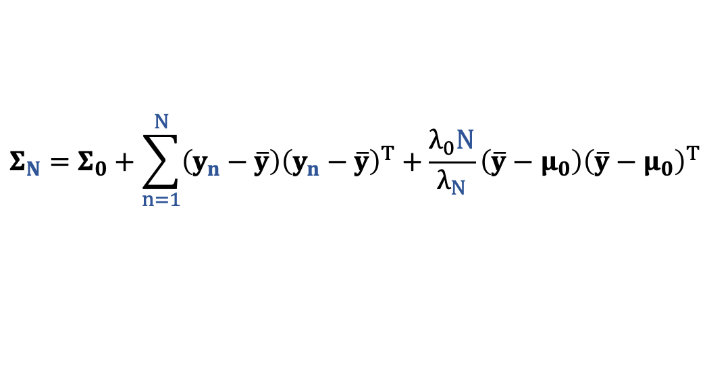
Extension to the multivariate case
Linear hierarchical model:
$$∀k=1,…,K, y_{k}=μ_{k}+ε_{k}, ε_{k} \sim 𝒩_{p}(0,Σ_{k}\text{)}$$
Priors:
$$μ_{k},Σ_{k}\sim {𝒩𝒲}^{−1}(μ_{0},λ_{0},Σ_{0},ν_{0})$$
Posteriors:
$$μ_{k},Σ_{k}|y_{k}\sim {𝒩𝒲}^{−1}(μ_{N},λ_{N},Σ_{N},ν_{N})$$
$$μ_{N}=\frac{N\overline{y}+μ_{0}λ_{0}}{N+λ_{0}}$$
$$ν_{N}=ν_{0}+N$$
$$Σ_{N}=Σ_{0}+\sum_{n=1}^{N}{\left(y_{n}−\overline{y}\right){\left(y_{n}−\overline{y}\right)}^{T}}+\frac{λ_{0}N}{λ_{N}}\left(\overline{y}−μ_{0}\right){\left(\overline{y}−μ_{0}\right)}^{T}$$
$$λ_{N}=λ_{0}+N$$
$$μ_{k}|y_{k}\sim T_{ν_{N}−P+1}\left(μ_{N},\frac{1}{λ_{N}\left(ν_{N}−P+1\right)}Σ_{N}\right)$$

Slide 29
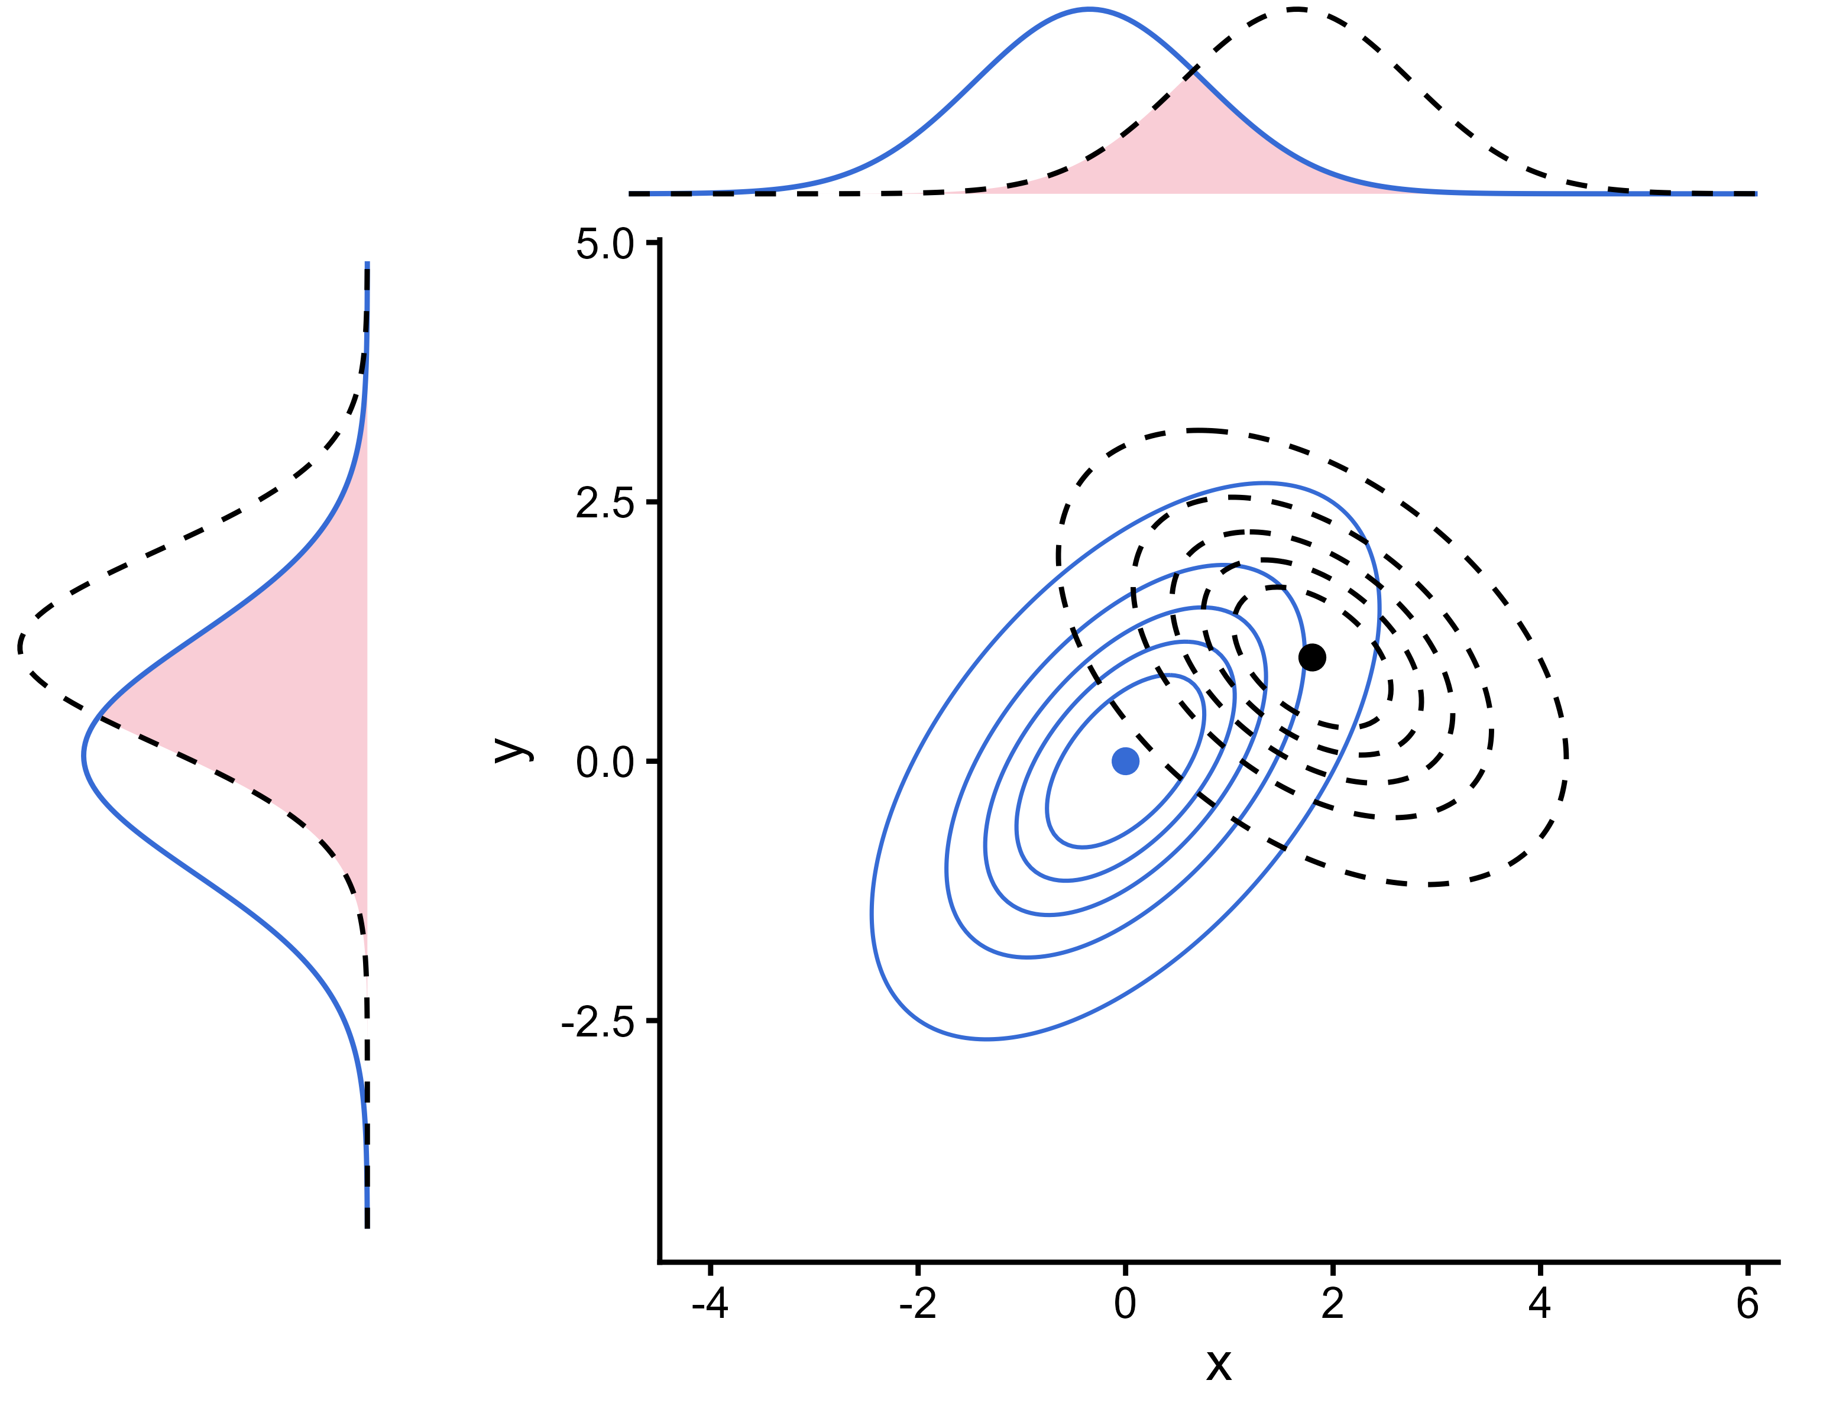
Multivariate inference
Overlap coefficient: similarity between two distributions as a probability.
Multivariate inference is not inference on marginals.
Uncertainty quantification can suffer from the curse of dimensionality, hard to summarise by a unique number.

Slide 30
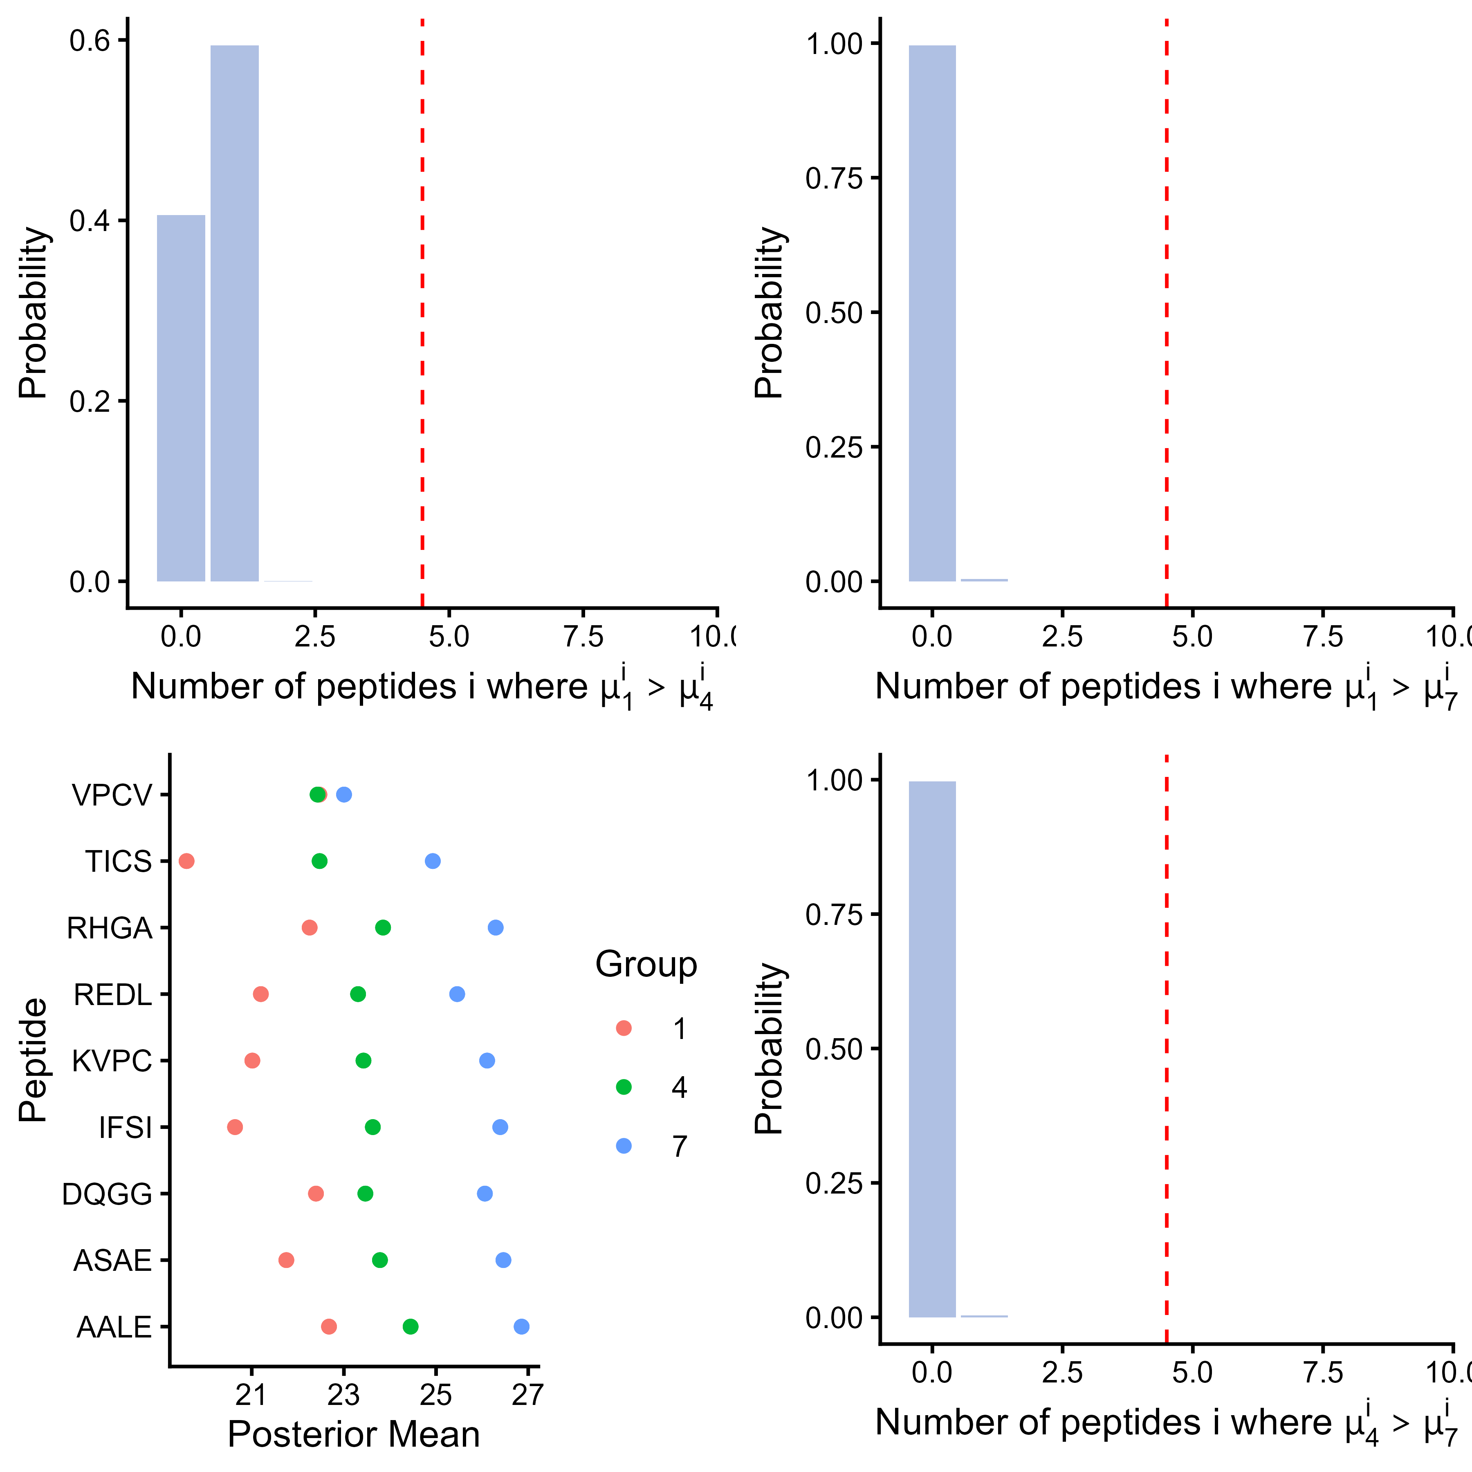
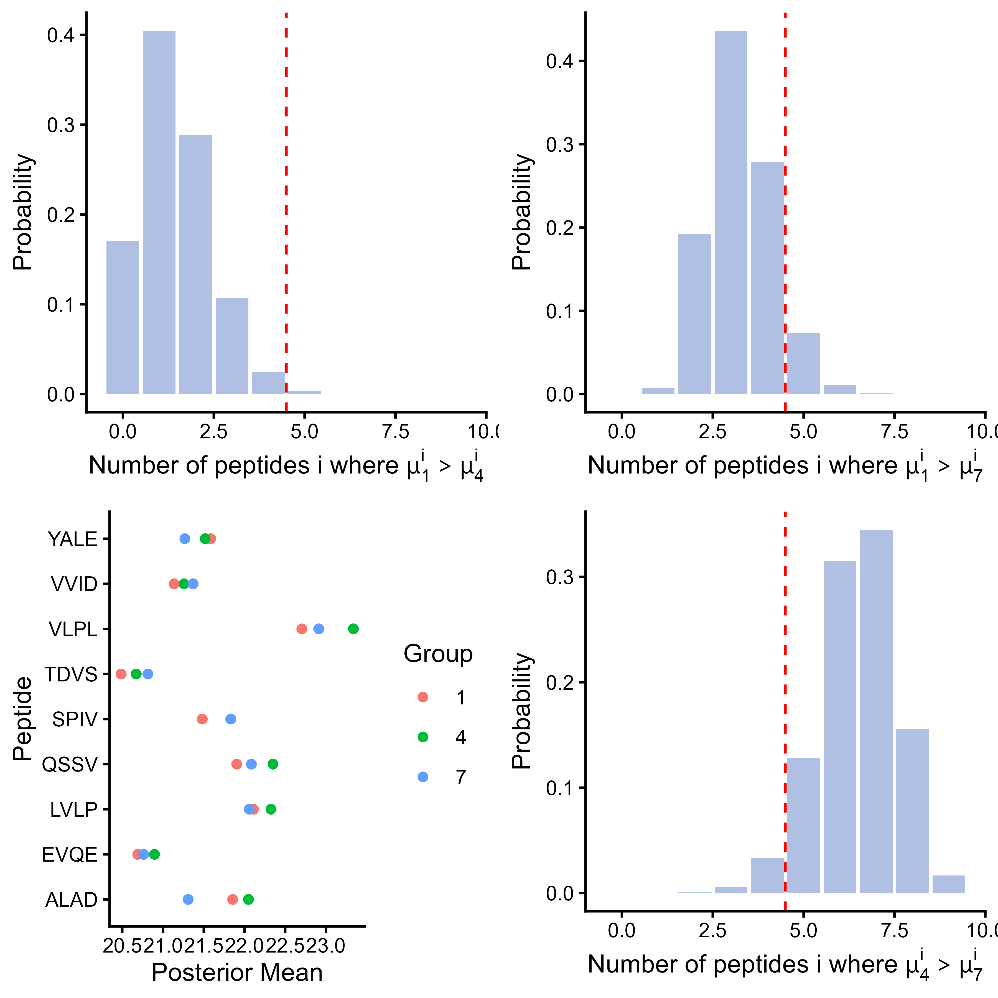
About protein inference
P12081ups|SYHC HUMAN UPS
sp|F4I893|ILA ARATH

Slide 31

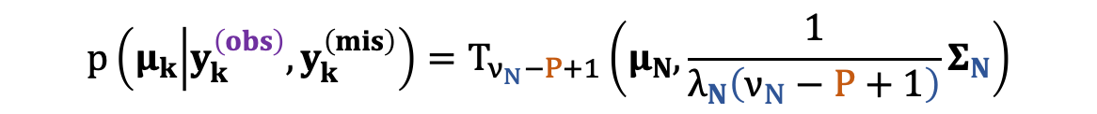
What about missing data?
Recall:
$$p\left(μ_{k} | y_{k}^{\left(obs\right)},y_{k}^{\left(mis\right)}\right)=T_{ν_{N}−P+1}\left(μ_{N},\frac{1}{λ_{N}\left(ν_{N}−P+1\right)}Σ_{N}\right)$$
Only If $y_{k}^{\left(obs\right)},y_{k}^{\left(mis\right)}$ were observed.

Slide 32


What about missing data?
Recall:
$$p\left(μ_{k} | y_{k}^{\left(obs\right)},y_{k}^{\left(mis\right)}\right)=T_{ν_{N}−P+1}\left(μ_{N},\frac{1}{λ_{N}\left(ν_{N}−P+1\right)}Σ_{N}\right)$$
Only If $y_{k}^{\left(obs\right)},y_{k}^{\left(mis\right)}$ were observed.
Multiple imputation:
$$y_{k}^{\left(obs\right)},y_{k}^{\left(mis\right)}$$
$$y_{k}^{\left(obs\right)},y_{k}^{(imp,d)}$$
D
Imputations
k-nearest neighbours,
maximum likelihood estimation, random forests, …
Initial dataset with missing values
Imputed datasets

Slide 33
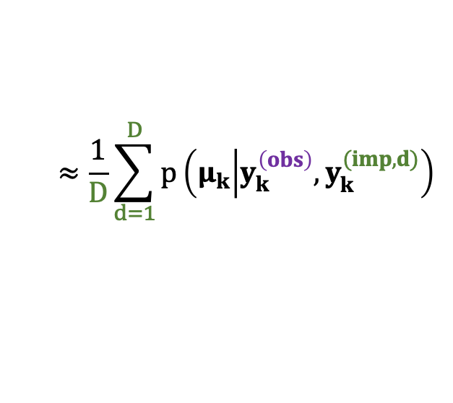
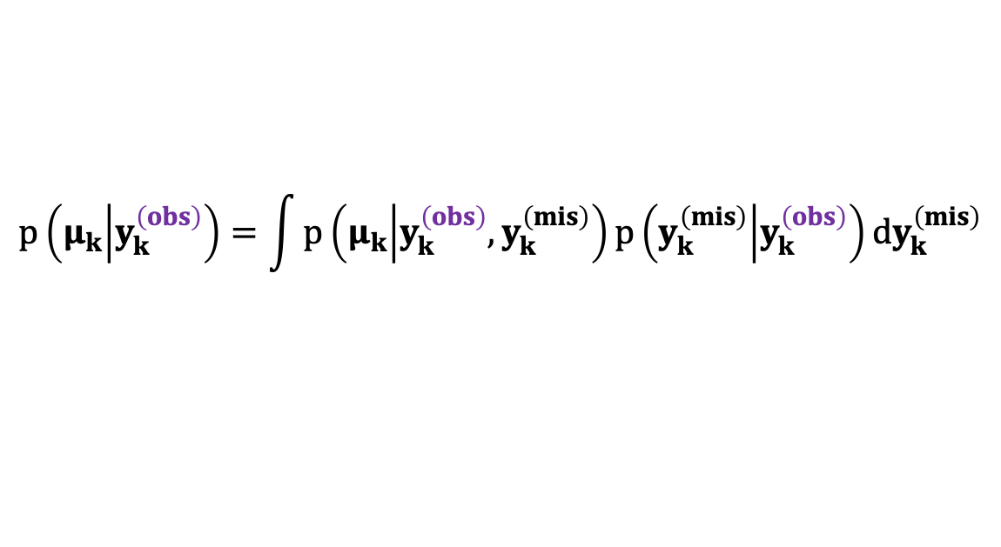
What about missing data?
Recall:
$$p\left(μ_{k} | y_{k}^{\left(obs\right)},y_{k}^{\left(mis\right)}\right)=T_{ν_{N}−P+1}\left(μ_{N},\frac{1}{λ_{N}\left(ν_{N}−P+1\right)}Σ_{N}\right)$$
Only If $y_{k}^{\left(obs\right)},y_{k}^{\left(mis\right)}$ were observed.
Rubin’s approximation:
$$p\left(μ_{k} | y_{k}^{\left(obs\right)}\right)=\int{{p\left(μ_{k} | y_{k}^{\left(obs\right)},y_{k}^{\left(mis\right)}\right)p\left(y_{k}^{\left(mis\right)} | y_{k}^{\left(obs\right)}\right)dy}_{k}^{\left(mis\right)}}$$
$$≈\frac{1}{D}\sum_{d=1}^{D}{p\left(μ_{k} | y_{k}^{\left(obs\right)},y_{k}^{(imp,d)}\right)}$$
 Rubin, 1987

Slide 34
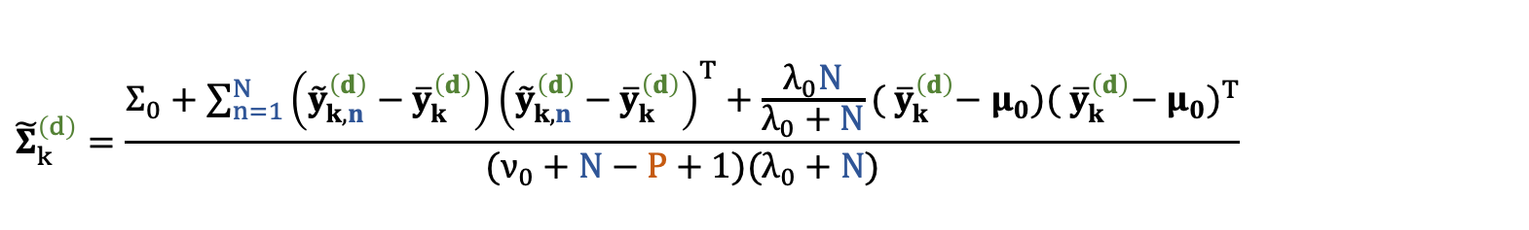
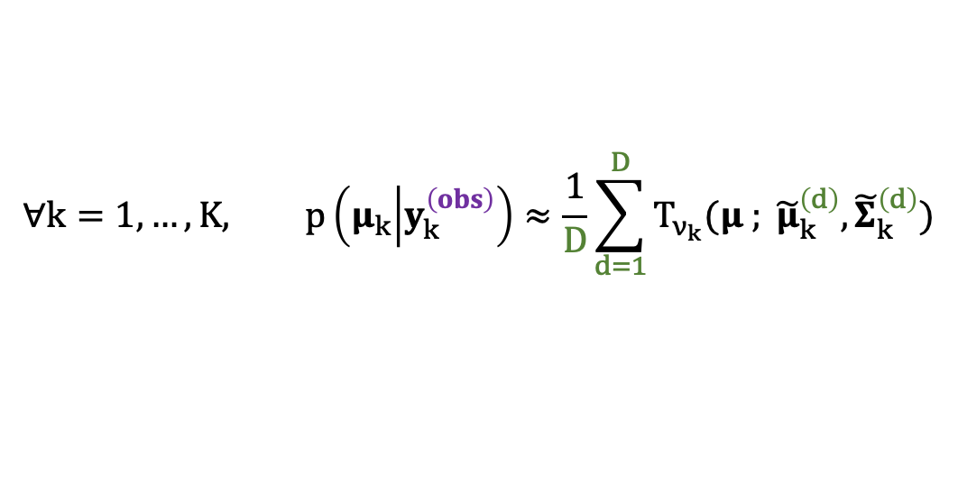
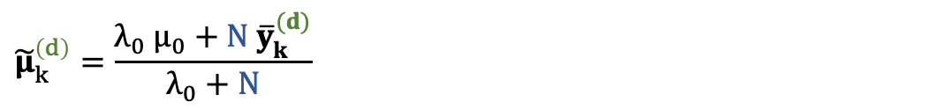
General Bayesian framework with multiple imputed values
$$∀k=1, …, K, p\left(μ_{k} | y_{k}^{\left(obs\right)}\right)≈\frac{1}{D}\sum_{d=1}^{D}{T_{ν_{k}}(μ ; {\tilde{μ}}_{k}^{\left(d\right)},{\tilde{Σ}}_{k}^{\left(d\right)})}$$
with:
$$ν_{k}=ν_{0}+N−P+1$$
$${\tilde{μ}}_{k}^{\left(d\right)}=\frac{λ_{0} μ_{0}+N{ \overline{y}}_{k}^{(d)}}{λ_{0}+N}$$
$${\tilde{Σ}}_{k}^{\left(d\right)}=\frac{Σ_{0}+\sum_{n=1}^{N}{\left({\tilde{y}}_{k,n}^{\left(d\right)}−{ \overline{y}}_{k}^{\left(d\right)}\right){\left({\tilde{y}}_{k,n}^{\left(d\right)}−{ \overline{y}}_{k}^{\left(d\right)}\right)}^{T}+\frac{λ_{0}N}{λ_{0}+N}({ \overline{y}}_{k}^{\left(d\right)}− μ_{0}){({ \overline{y}}_{k}^{\left(d\right)}− μ_{0})}^{T}}}{(ν_{0}+N−P+1)(λ_{0}+N)}$$

Slide 35
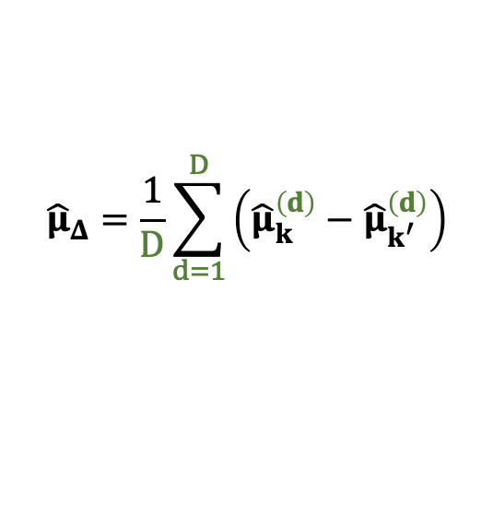

General Bayesian framework with multiple imputed values
$$∀k=1, …, K, p\left(μ_{k} | y_{k}^{\left(obs\right)}\right)≈\frac{1}{D}\sum_{d=1}^{D}{T_{ν_{k}}(μ ; {\tilde{μ}}_{k}^{\left(d\right)},{\tilde{Σ}}_{k}^{\left(d\right)})}$$
with:
$$ν_{k}=ν_{0}+N−P+1$$
$${\tilde{μ}}_{k}^{\left(d\right)}=\frac{λ_{0} μ_{0}+N{ \overline{y}}_{k}^{(d)}}{λ_{0}+N}$$
$${\tilde{Σ}}_{k}^{\left(d\right)}=\frac{Σ_{0}+\sum_{n=1}^{N}{\left({\tilde{y}}_{k,n}^{\left(d\right)}−{ \overline{y}}_{k}^{\left(d\right)}\right){\left({\tilde{y}}_{k,n}^{\left(d\right)}−{ \overline{y}}_{k}^{\left(d\right)}\right)}^{T}+\frac{λ_{0}N}{λ_{0}+N}({ \overline{y}}_{k}^{\left(d\right)}− μ_{0}){({ \overline{y}}_{k}^{\left(d\right)}− μ_{0})}^{T}}}{(ν_{0}+N−P+1)(λ_{0}+N)}$$
$${\hat{μ}}_{Δ}=\frac{1}{D}\sum_{d=1}^{D}{\left({\hat{μ}}_{k}^{\left(d\right)}−{\hat{μ}}_{k^{′}}^{\left(d\right)}\right)}$$
$∀k=1,…, K,$ draw ${\hat{μ}}_{k}^{\left(d\right)}\sim T_{ν_{k}}\left(μ ; {\tilde{μ}}_{k}^{\left(d\right)},{\tilde{Σ}}_{k}^{\left(d\right)}\right)$
Sample from the
difference distribution

Slide 36

Conclusion & Perspectives
Conjugate Bayesian model for differential expression analysis allowing for missing values, correlation structure and uncertainty quantification.
Preprint available on arXiv
Implemented as the ProteoBayes R package (CRAN) and a Shiny (no-code) App.
Next steps:
  Create a tutorial on ProteoBayes
  Expand to other omics data (non-Normal distributions)
Contact: marie.chion@protonmail.com

Slide 38


Multiple imputation in proteomics
Imputed datasets combination
Moderated
t-test
Multiple
imputation
N Samples
N Samples
$$y_{p}$$
$${\hat{y}}_{p}^{d}$$
D
Imputations
k-nearest neighbours,
maximum likelihood estimation, random forests, …
Initial dataset with missing values
Imputed datasets
 Rubin, 1987

Slide 39





Multiple imputation in proteomics
Imputed datasets combination
Moderated
t-test
Multiple
imputation
Using the mean
DAPAR/ProStaR
 Giai-Gianetto et al., 2020
PANDA-view
 Chang et al., 2018
N Samples
N Samples
K Groups
$${\hat{y}}_{p}$$
$${\hat{β}}_{p}$$
$${\hat{y}}_{p}^{d}$$
D
Imputations
+ Decrease in the spread of the bias of the parameters estimator
- Underestimation of the parameters estimator variance
Multiple imputation
Improved single imputation

Slide 40
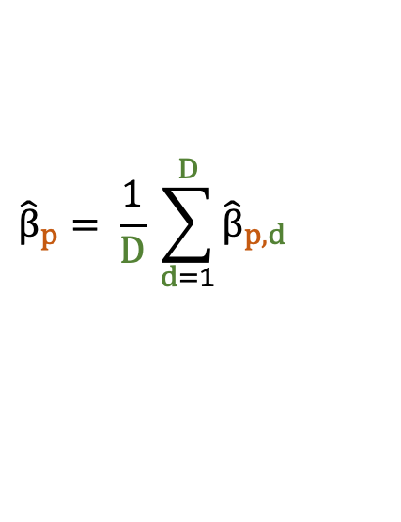



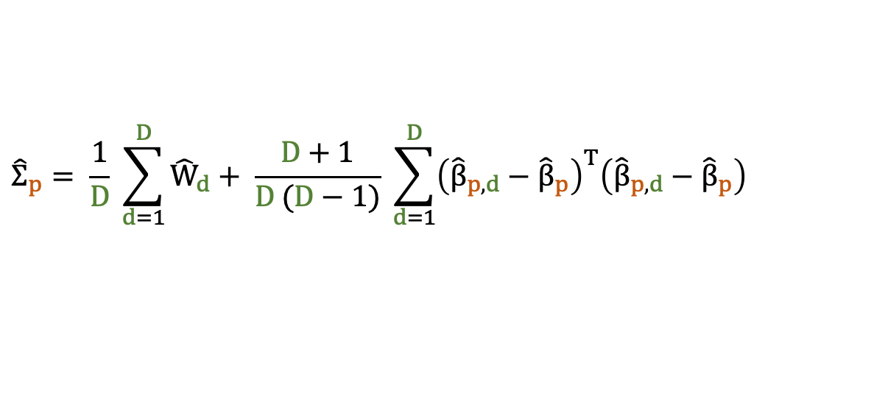
Estimation from multiple imputations
Imputed datasets combination
Moderated
t-test
Multiple
imputation
 Little and Rubin (2002)
Using the Rubin’s rules
N Samples
$${\hat{β}}_{p}$$
K
$${\hat{y}}_{p,d}$$
D
Imputations
K Groups
$${\hat{Σ}}_{p}$$
$${\hat{β}}_{p}= \frac{1}{D} \sum_{d=1}^{D}{{\hat{β}}_{p,d}}$$
Where:
$${\hat{Σ}}_{p}= \frac{1}{D} \sum_{d=1}^{D}{{\hat{W}}_{d}}+ \frac{D+1}{D (D−1)} \sum_{d=1}^{D}{{\left({\hat{β}}_{p,d}−{\hat{β}}_{p}\right)}^{T}\left({\hat{β}}_{p,d}−{\hat{β}}_{p}\right)}$$

Slide 41


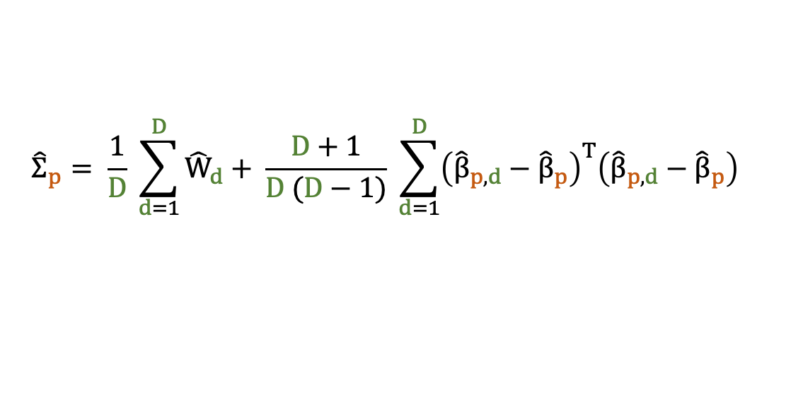

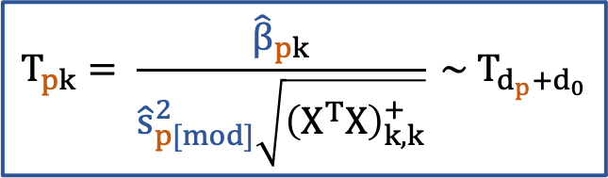
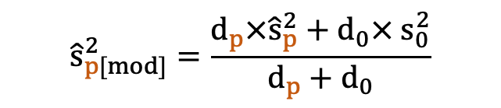
Accounting for multiple imputation variance
Imputed datasets combination
Covariance matrix projection
Moderated
t-test
Multiple
imputation
Recall:
$${\hat{Σ}}_{p}= \frac{1}{D} \sum_{d=1}^{D}{{\hat{W}}_{d}}+ \frac{D+1}{D (D−1)} \sum_{d=1}^{D}{{\left({\hat{β}}_{p,d}−{\hat{β}}_{p}\right)}^{T}\left({\hat{β}}_{p,d}−{\hat{β}}_{p}\right)}$$
(Matrix of size K x K)
Then:
$${\hat{s}}_{p[mod]}^{2}=\frac{d_{p}×{\hat{s}}_{p}^{2}+d_{0}× s_{0}^{2}}{d_{p}+d_{0}}$$
$${\hat{s}}_{p}^{2}= \max_{k}{({\hat{Σ}}_{p,(k,k)}X^{T}X)}$$
And under $H_{0}:β_{pk}=0,$
Chion et al. (2022)
$$T_{pk}= \frac{{\hat{β}}_{pk}}{{\hat{s}}_{p[mod]}^{2}\sqrt{{\left(X^{T}X\right)}_{k,k}^{+}}} \sim { T}_{d_{p}+d_{0}}$$
mi4p package

Slide 42

A quick reminder about the Bayesian framework
Updating our knowledge of a theory T using the data D:
likelihood
probability of observing the data D if theory T is true
prior knowledge
probability of a theory T to be true
$$P\left(T | D\right)=\frac{P\left(D | T\right) × P\left(T\right)}{P\left(D\right)}$$
posterior knowledge
probability of theory T to be true based on the data D
normalising constant
probability of observing
the data D

Slide 43
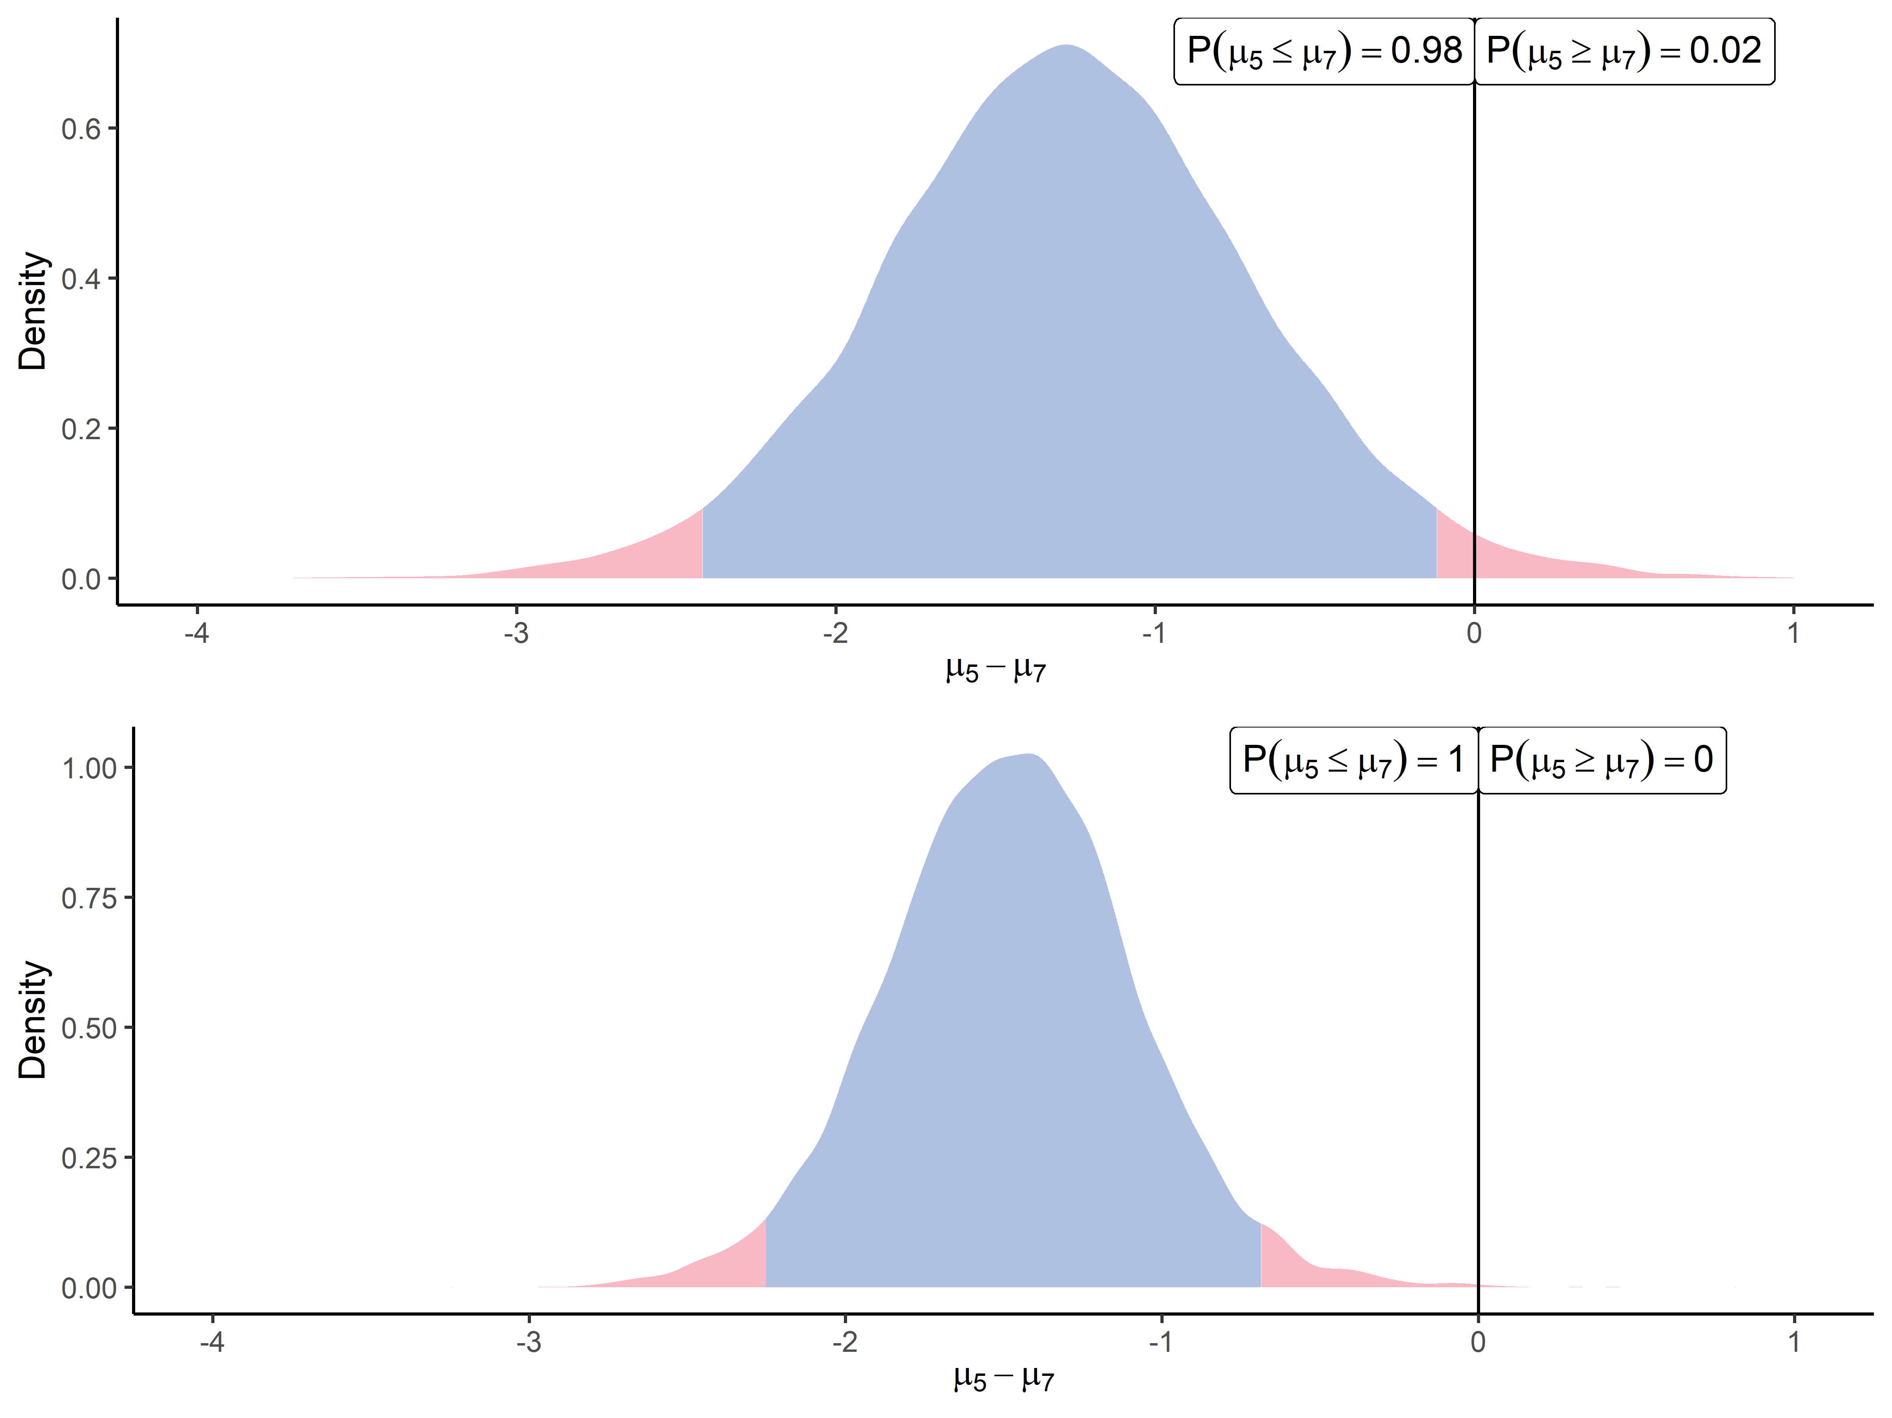
Benefits of intra-protein correlation
AALEELVK
(P12081ups|SYHC HUMAN UPS)
Univariate approach
Multivariate approach

